Slide 1
IBM Employee Attrition
Andrew Frazier – DS5K CAPSTONE Presentation

Slide 2
Picking the Data Source
A Case Study Using IBM's Notional HR Data
The are many outright and hidden costs to employees choosing to leave the Firm. Whether it's the cost of recruiting, hiring, on-boarding and training another employee to replace them; the cost of lost revenue and productivity; the impact to our reputation with customers; or the setback in our goal to build out an Analytics capability which will help transform our client spaces over time - there is no question that losing talent hurts the business.
All that said - attrition at some level is a fact of life. The questions are: How can data help us understand what drives attrition and if we understand some of the factors that help us predict an increased probability that an employee may leave the team - can we take action to keep our best performers?
Hypothesis
A Hypothesis for this data science project is that there are one or more variables in an HR dataset which can help an organization predict the potential that an employee may to resign with a reasonable degree of confidence.
Goals, Success Measures and Risks
The goal for this project will be to do exploratory analysis on an HR dataset which contains some common information on employees to include if they have left the business. This will be followed by identification of feature variables which have a strong positive or negative relationship on employees who stay or leave. Some initial measures of success will include the identification of one or two variables which have a strong correlation to attrition/retention and then the ability to successfully build one or more models which can be used to predict if an employee is likely to stay or leave an organization.
There are many inherent risks and limitations in this analysis. Some of them include the possibility that the strongest predictors for attrition are not contained in the data set or that the data has quality limitations. It is likely that even strong predictors are by no means a guarantee that an employee may leave - and so the use of this information could have negative consequences if not handled correctly. Another risk for the goals of this project, is that the results from this data set are not transferable to other populations of employees. There are also the risks/limitations of the ability to consistently collect data across different organizations.
Source and Data Set
The dataset I have chosen for this project is from Kaggle datasets, titled "IBM HR Analytics Employee Attrition & Performance: WAFn-UseC-HR-Employee-Attrition.csv". It is a fictional dataset provided by IBM data scientists and will serve as a useful exercise for this type of problem. Perhaps the methodology and approaches in this capstone project can be applied to other employee datasets to understand if the model produces similar predictive power when tested against real population datasets. The data does have some challenges - two in particular. First there is a concern that the number of records is on 1.4K - not large enough for the type of modeling I'd like to do. I can use the 'bootstrap' methodology to expand the volume of records. The second concern is that the data set is 'fake'. It is not clear from the description if it's based on real findings from IBM and can be extrapolated to real predictors if it is simply used to practice building HR models. For this exercise I am assuming it is a reasonable representation of a real workforce and has been sanitized to protect any privacy and business sensitivities.

Slide 3
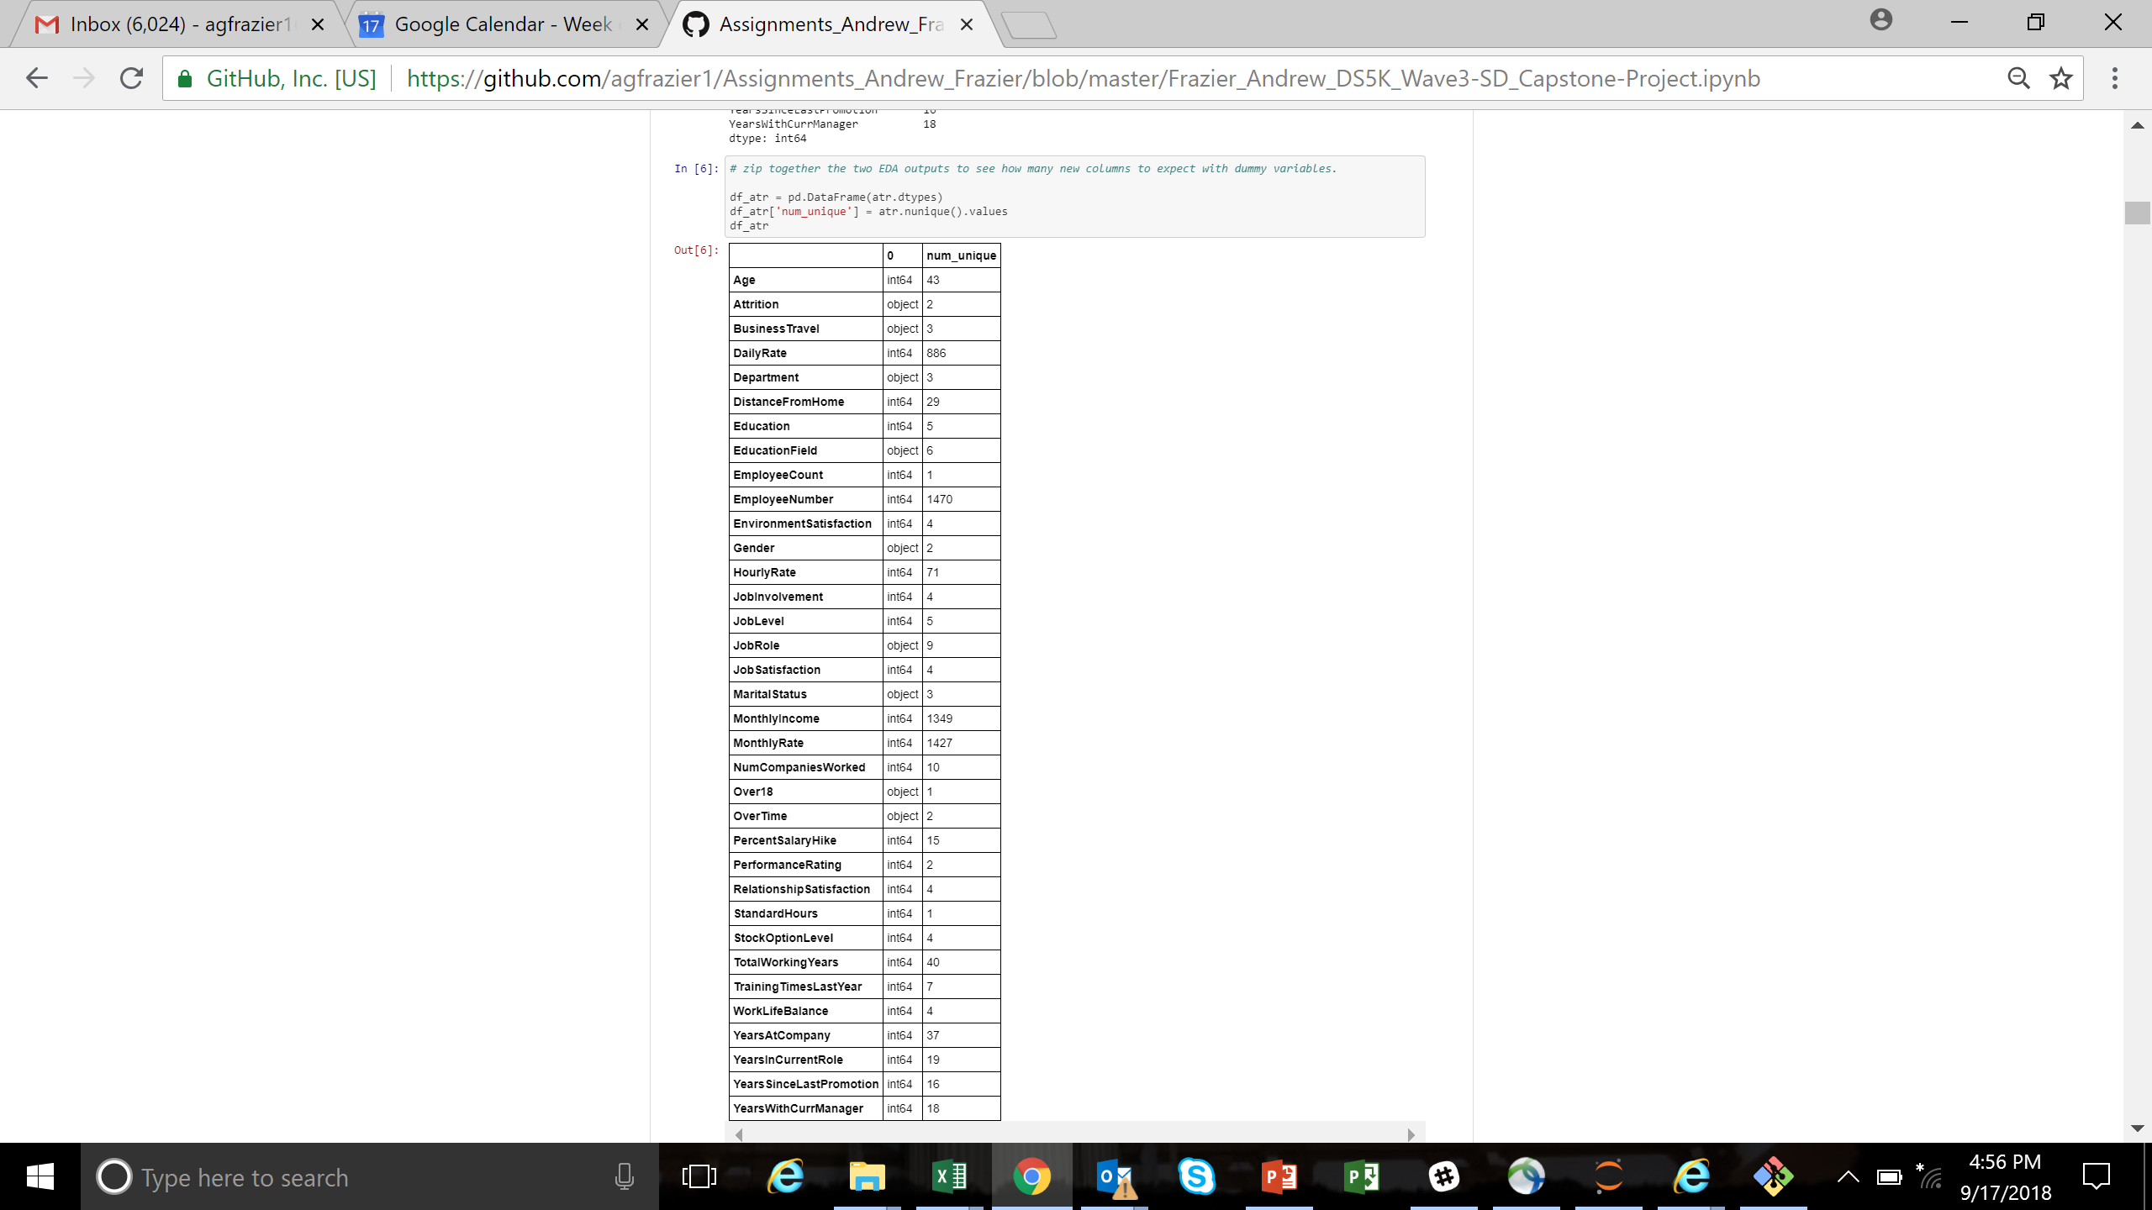
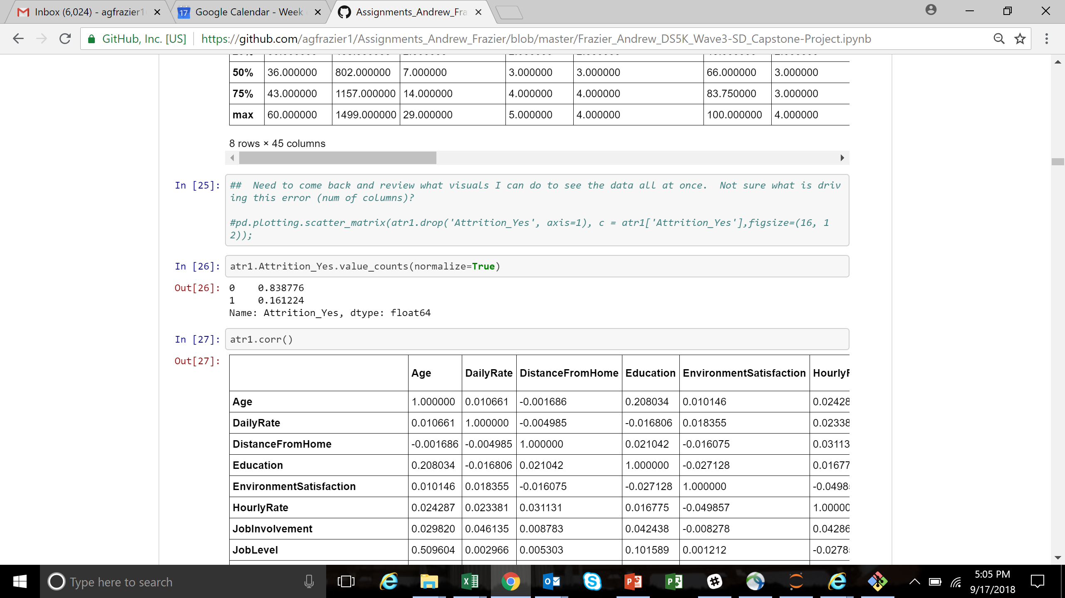
Exploratory Data Analysis
This was the hard part for this data set (for me…)
Pretty clean data set (1,470 rows, 35 columns)
Drop features such as Employee Number, Employee Count, Over_18, Standard Hours
A lot of categorical features - “Get Dummies”
Objective was to explore attrition – categorical ‘predictor’: Attrition_Yes
Next step – explore the features….
This is where it got harder

Slide 4
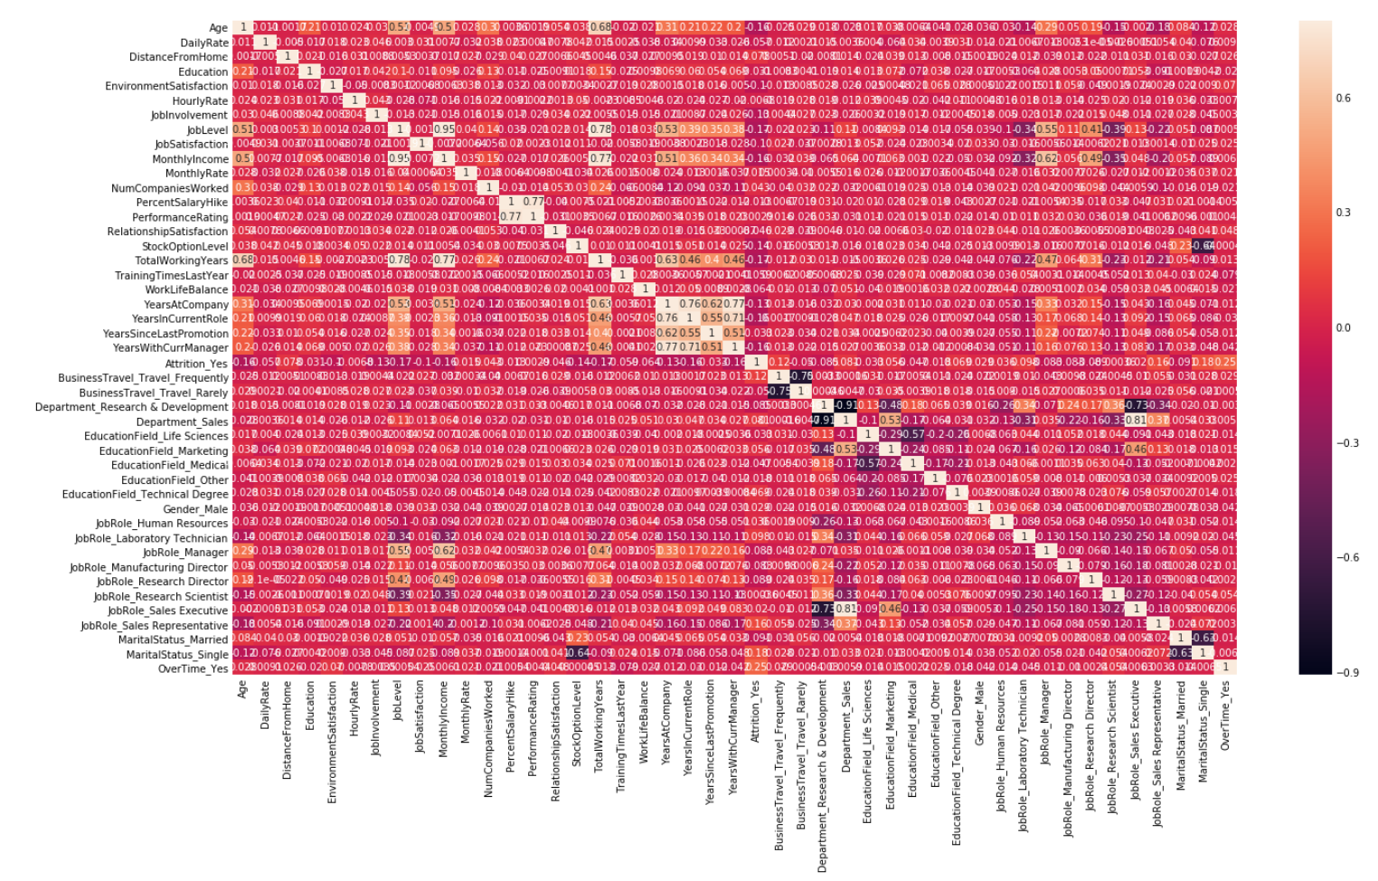
Exploring Features – Data Visualizations

Slide 5
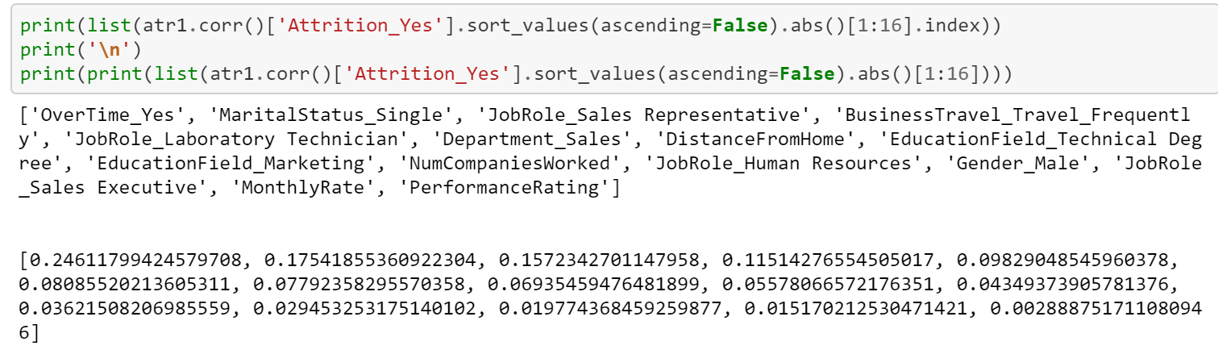
Exploring Features – Data Visualizations

Slide 6
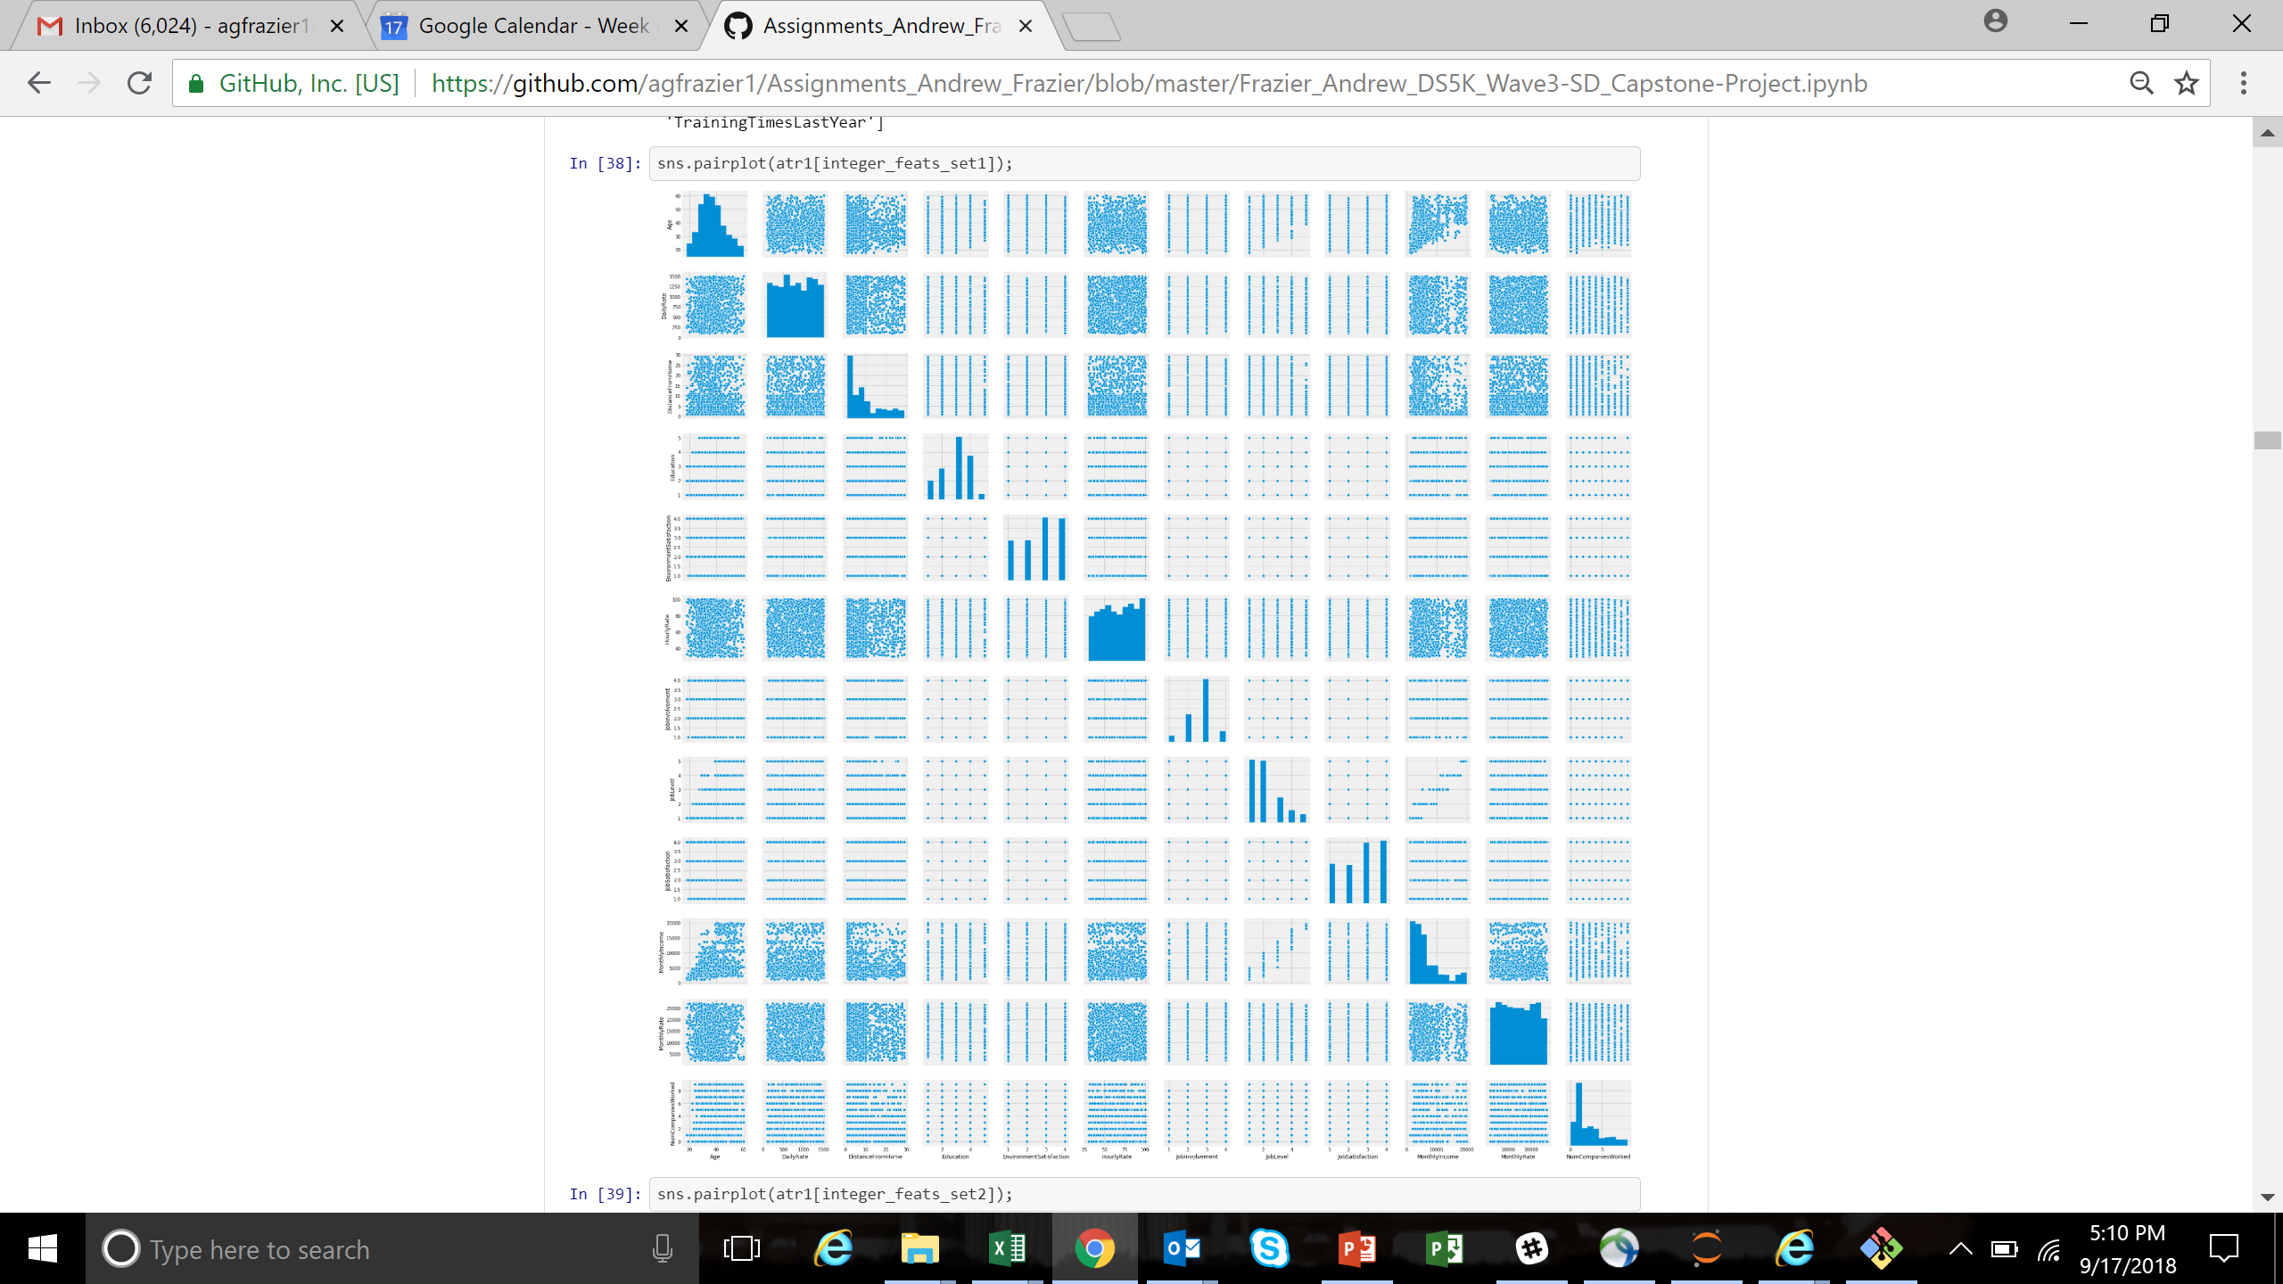
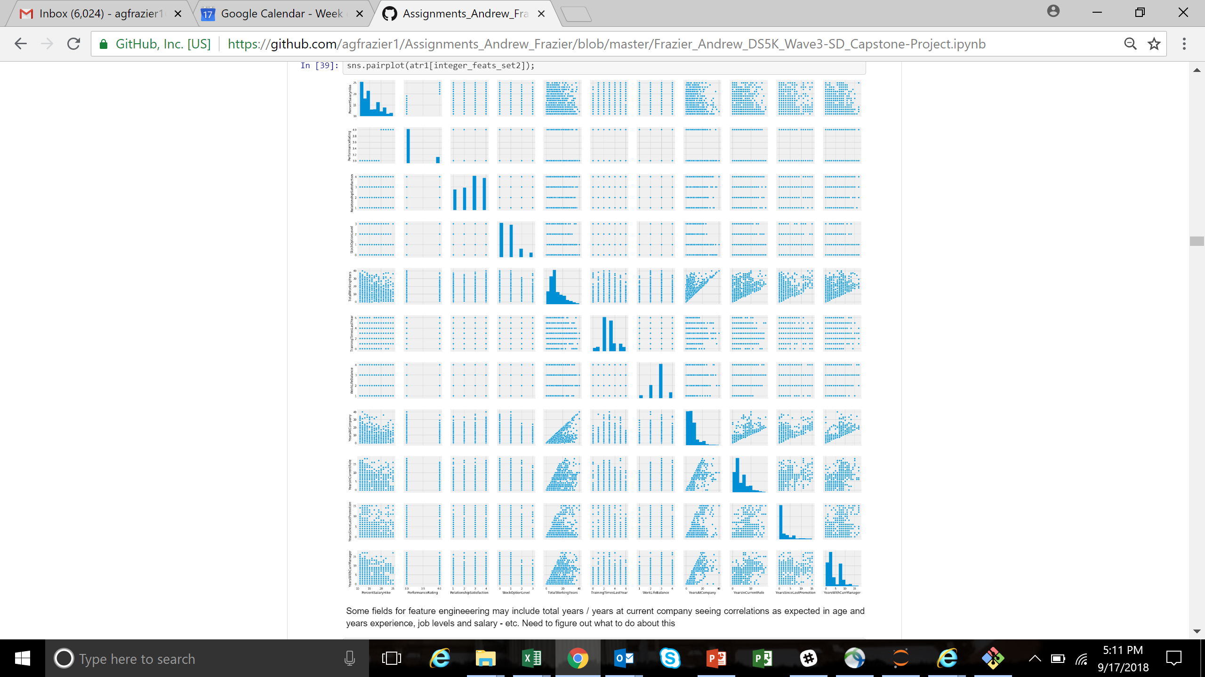
Exploring Features – Data Visualizations

Slide 7
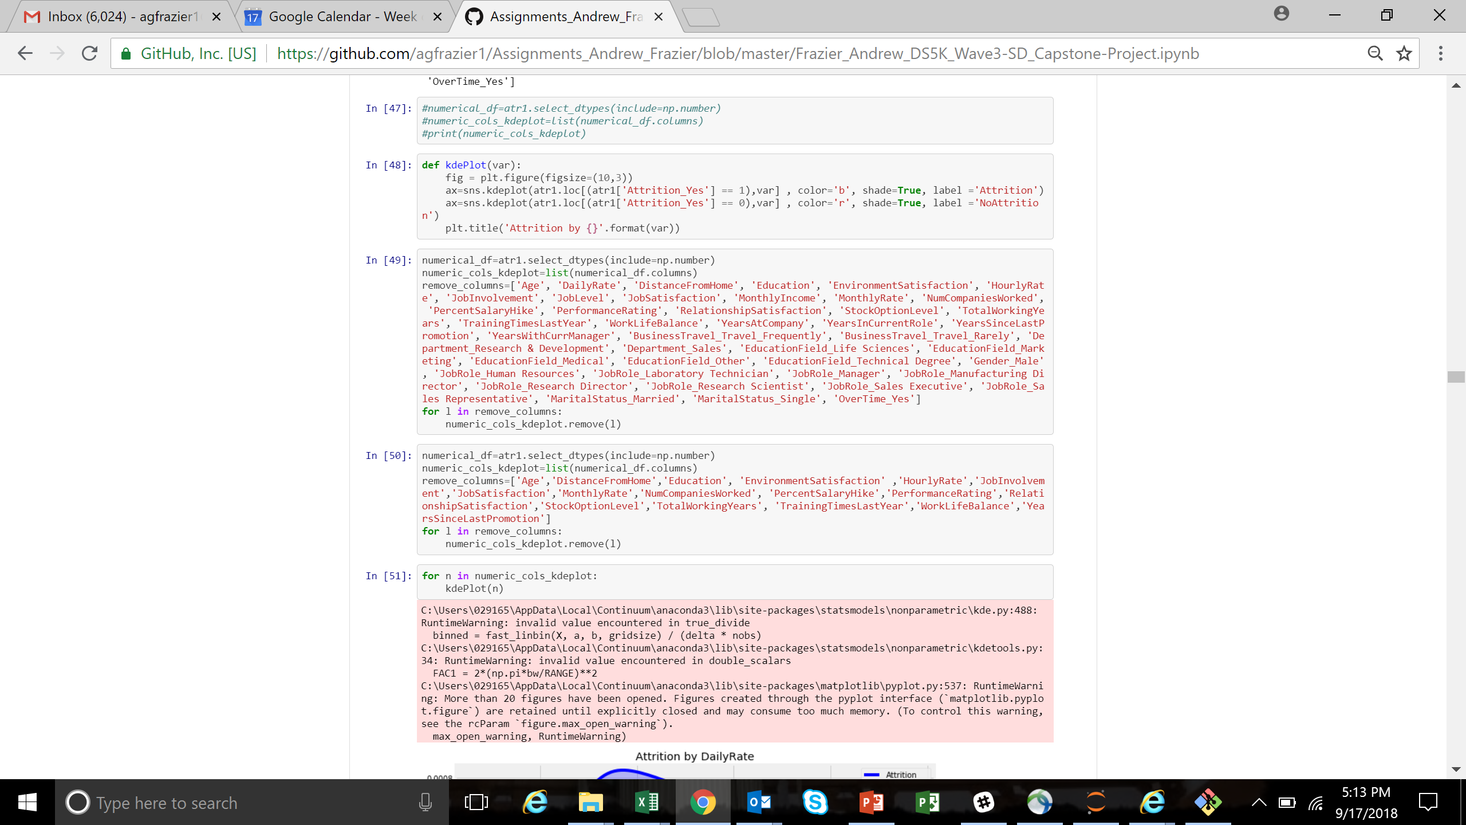
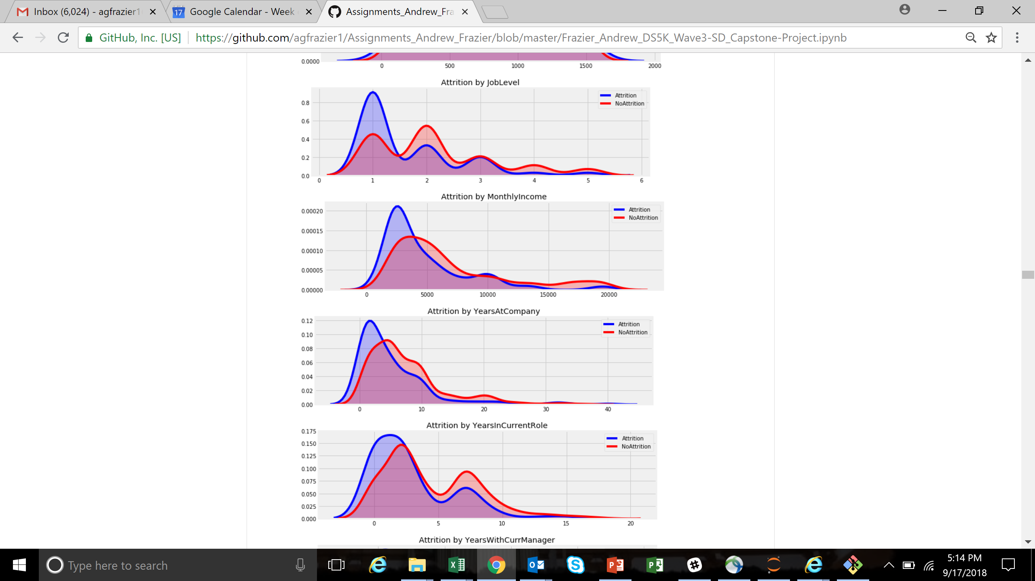
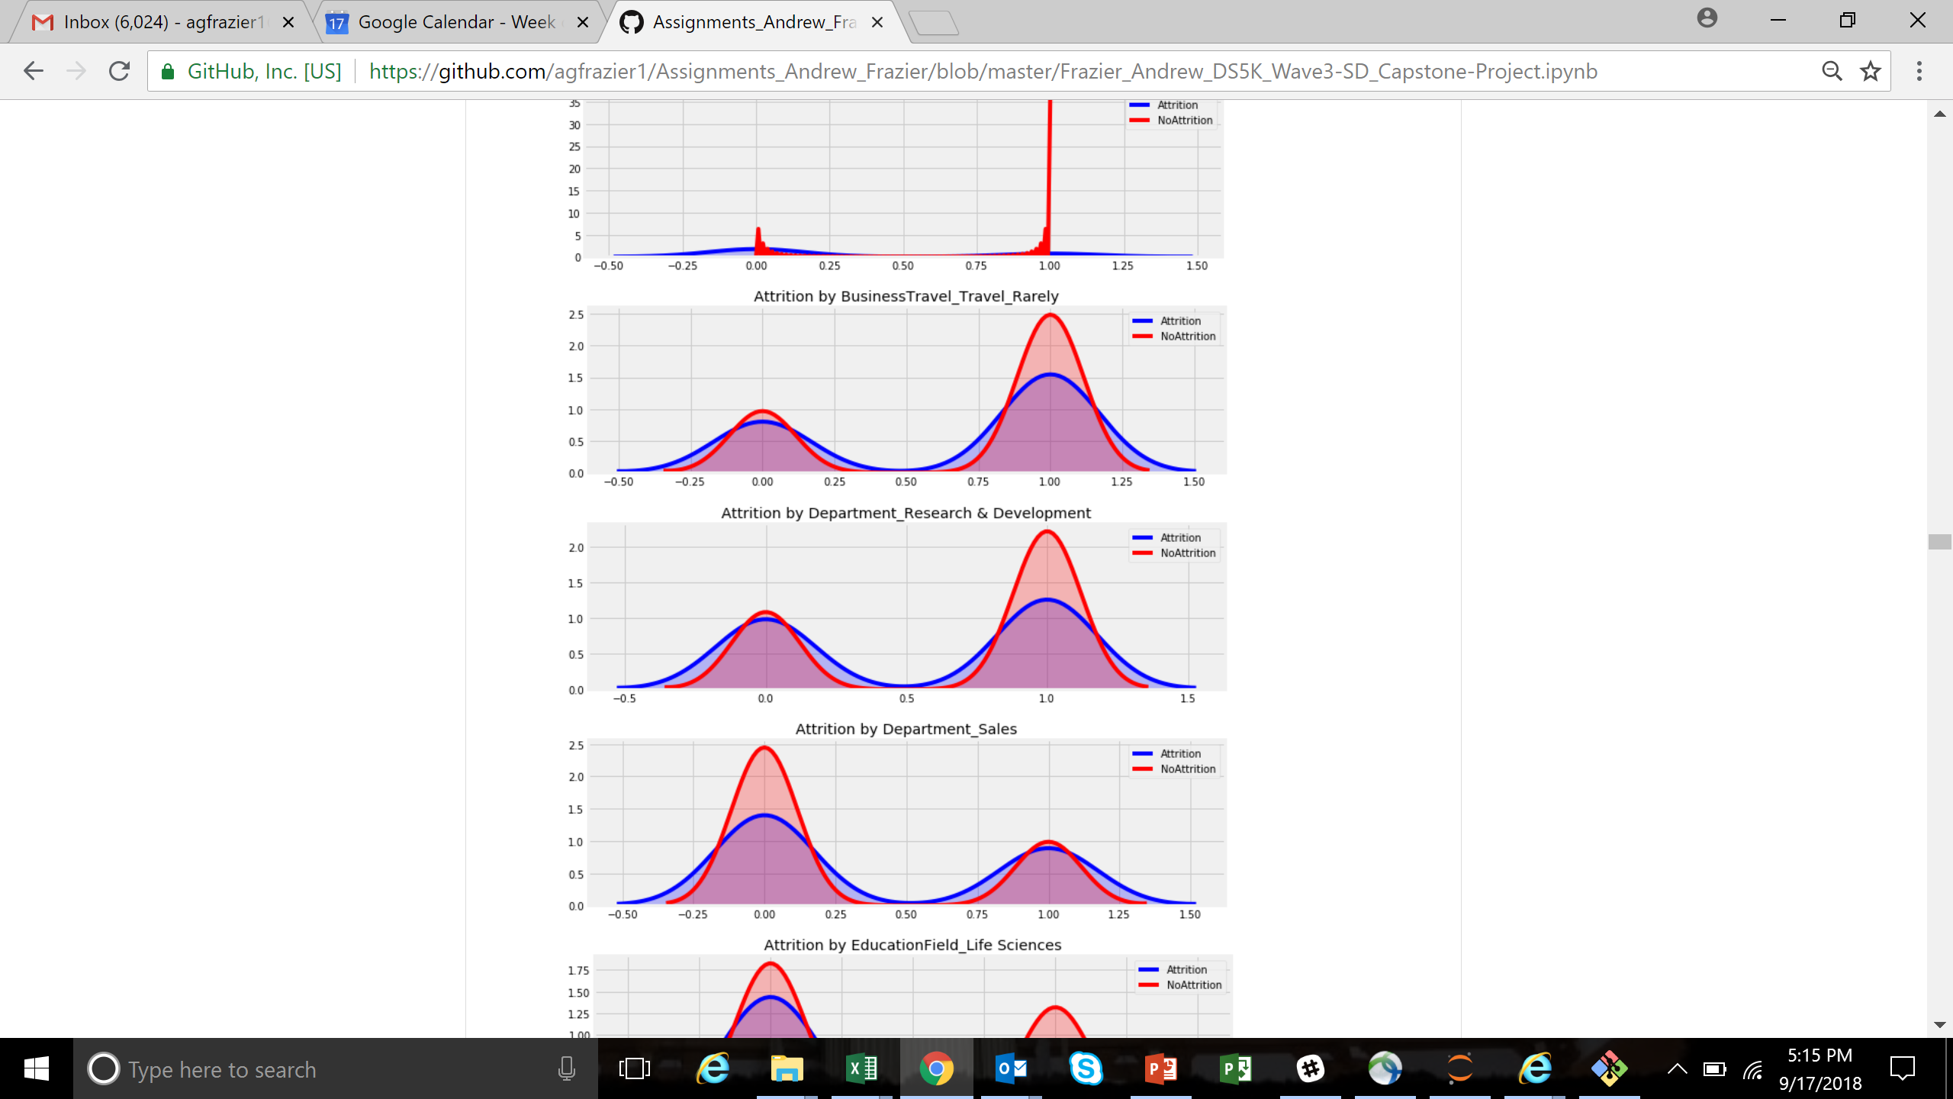
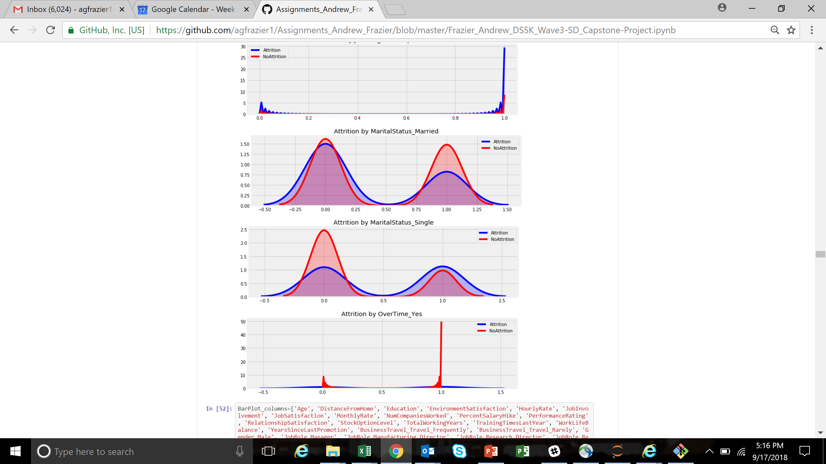
Exploring Features – Data Visualizations

Slide 8
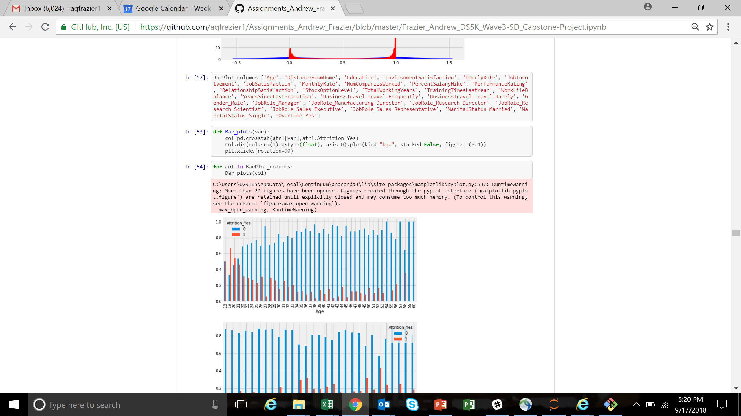
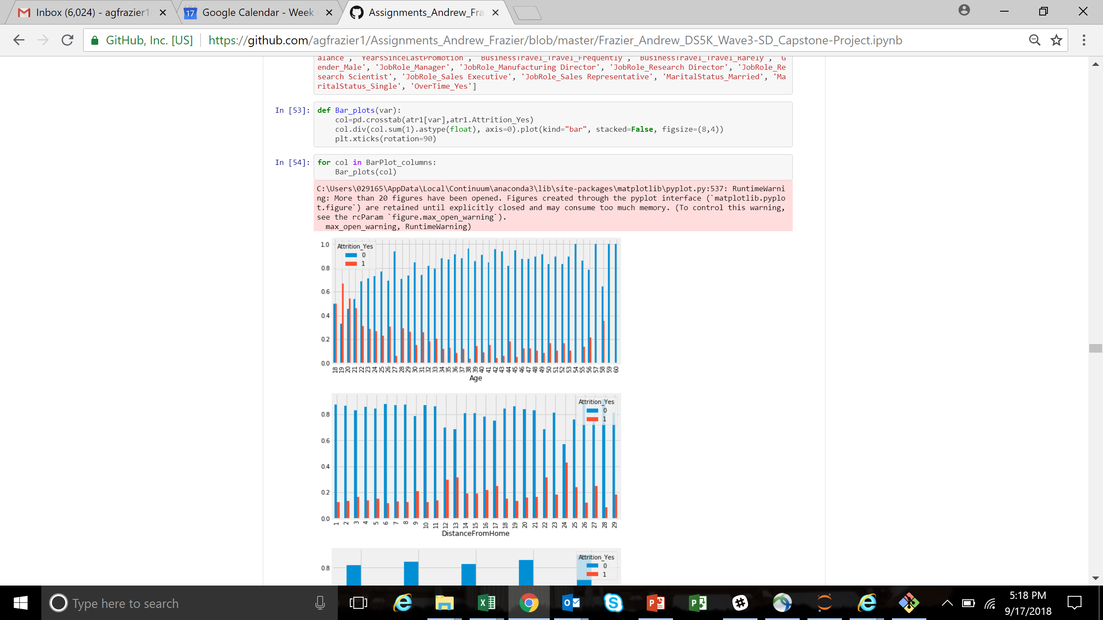
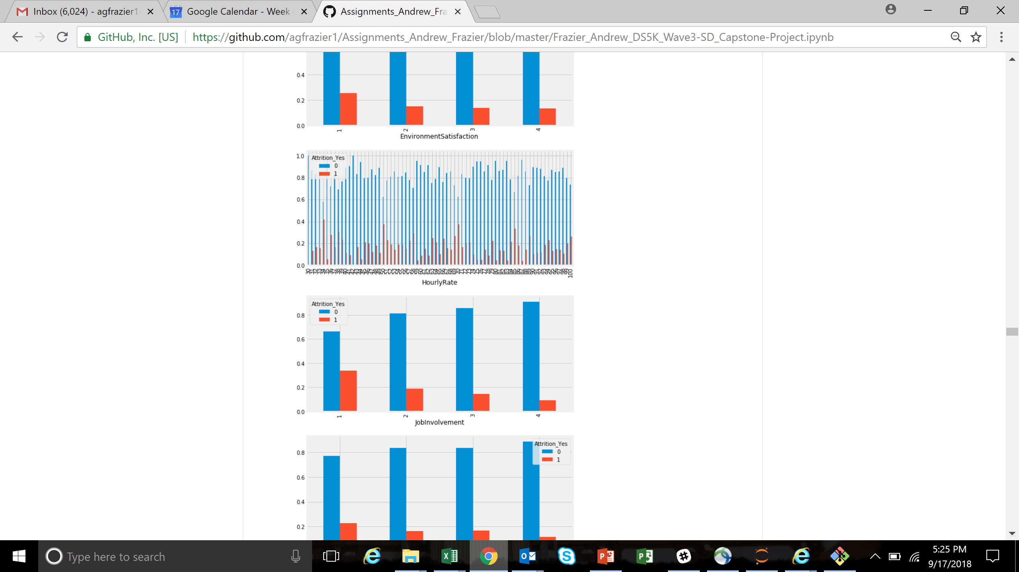
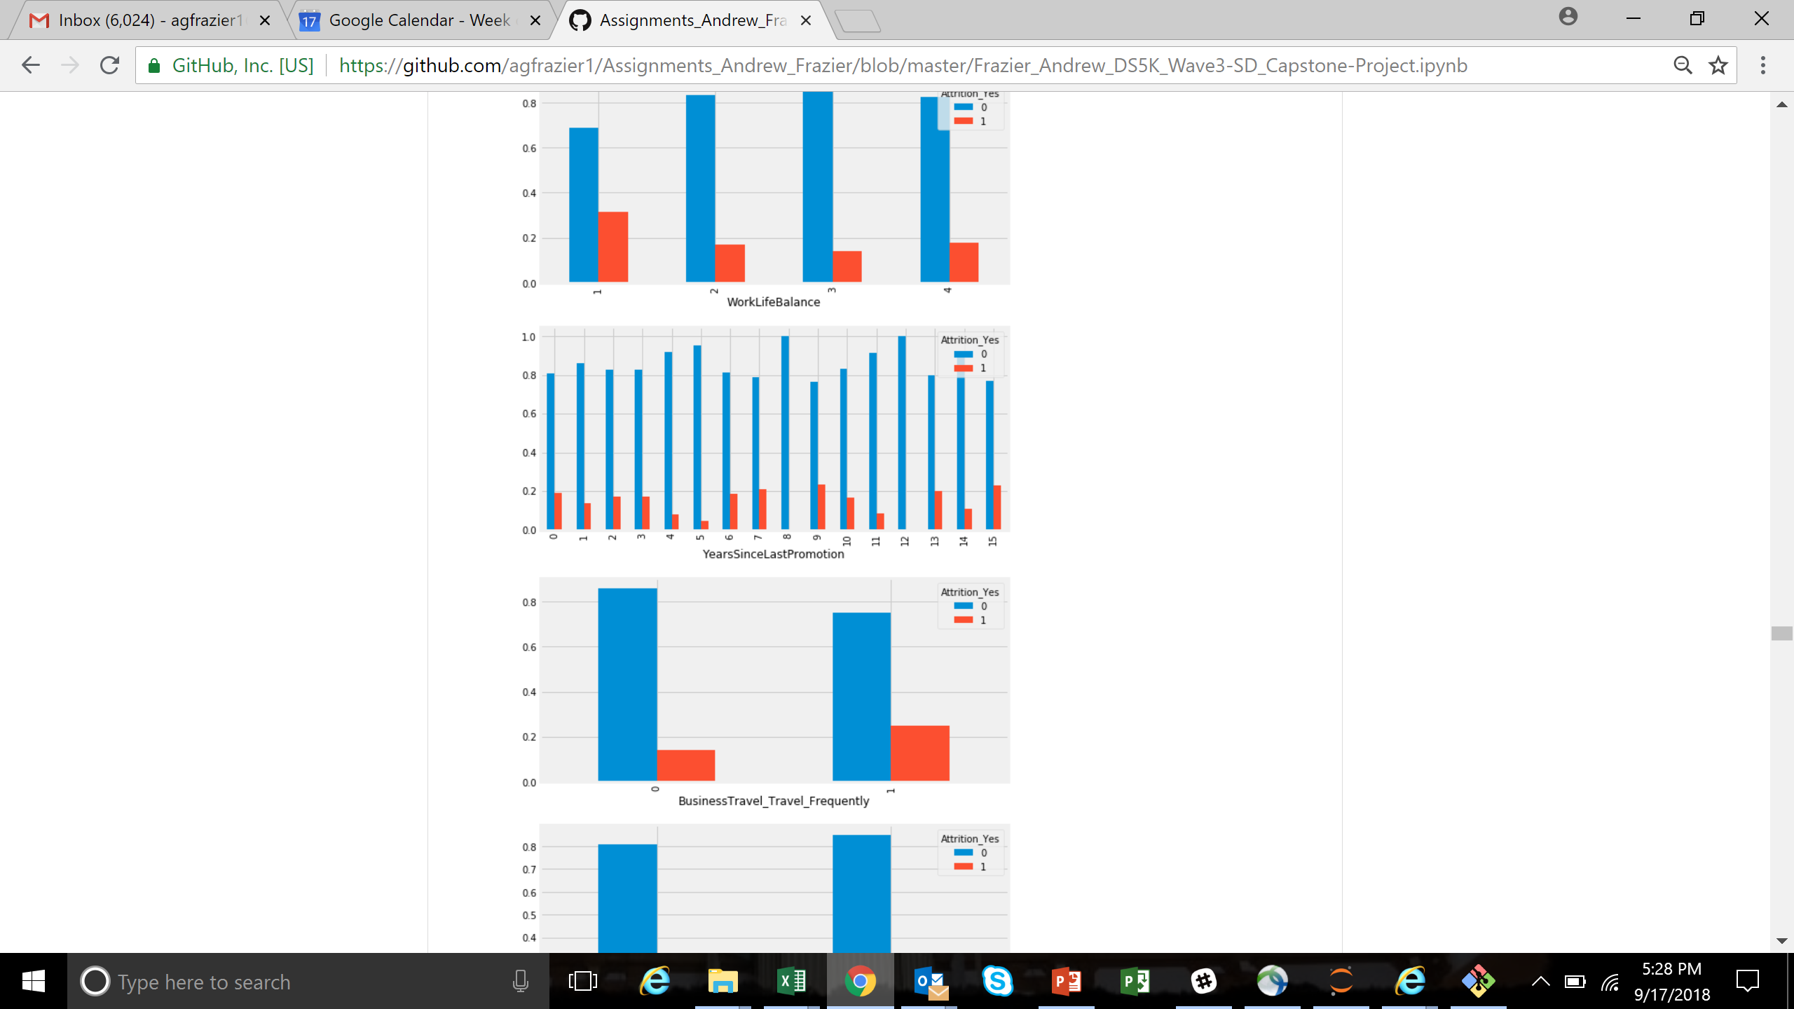
Exploring Features – Data Visualizations

Slide 9
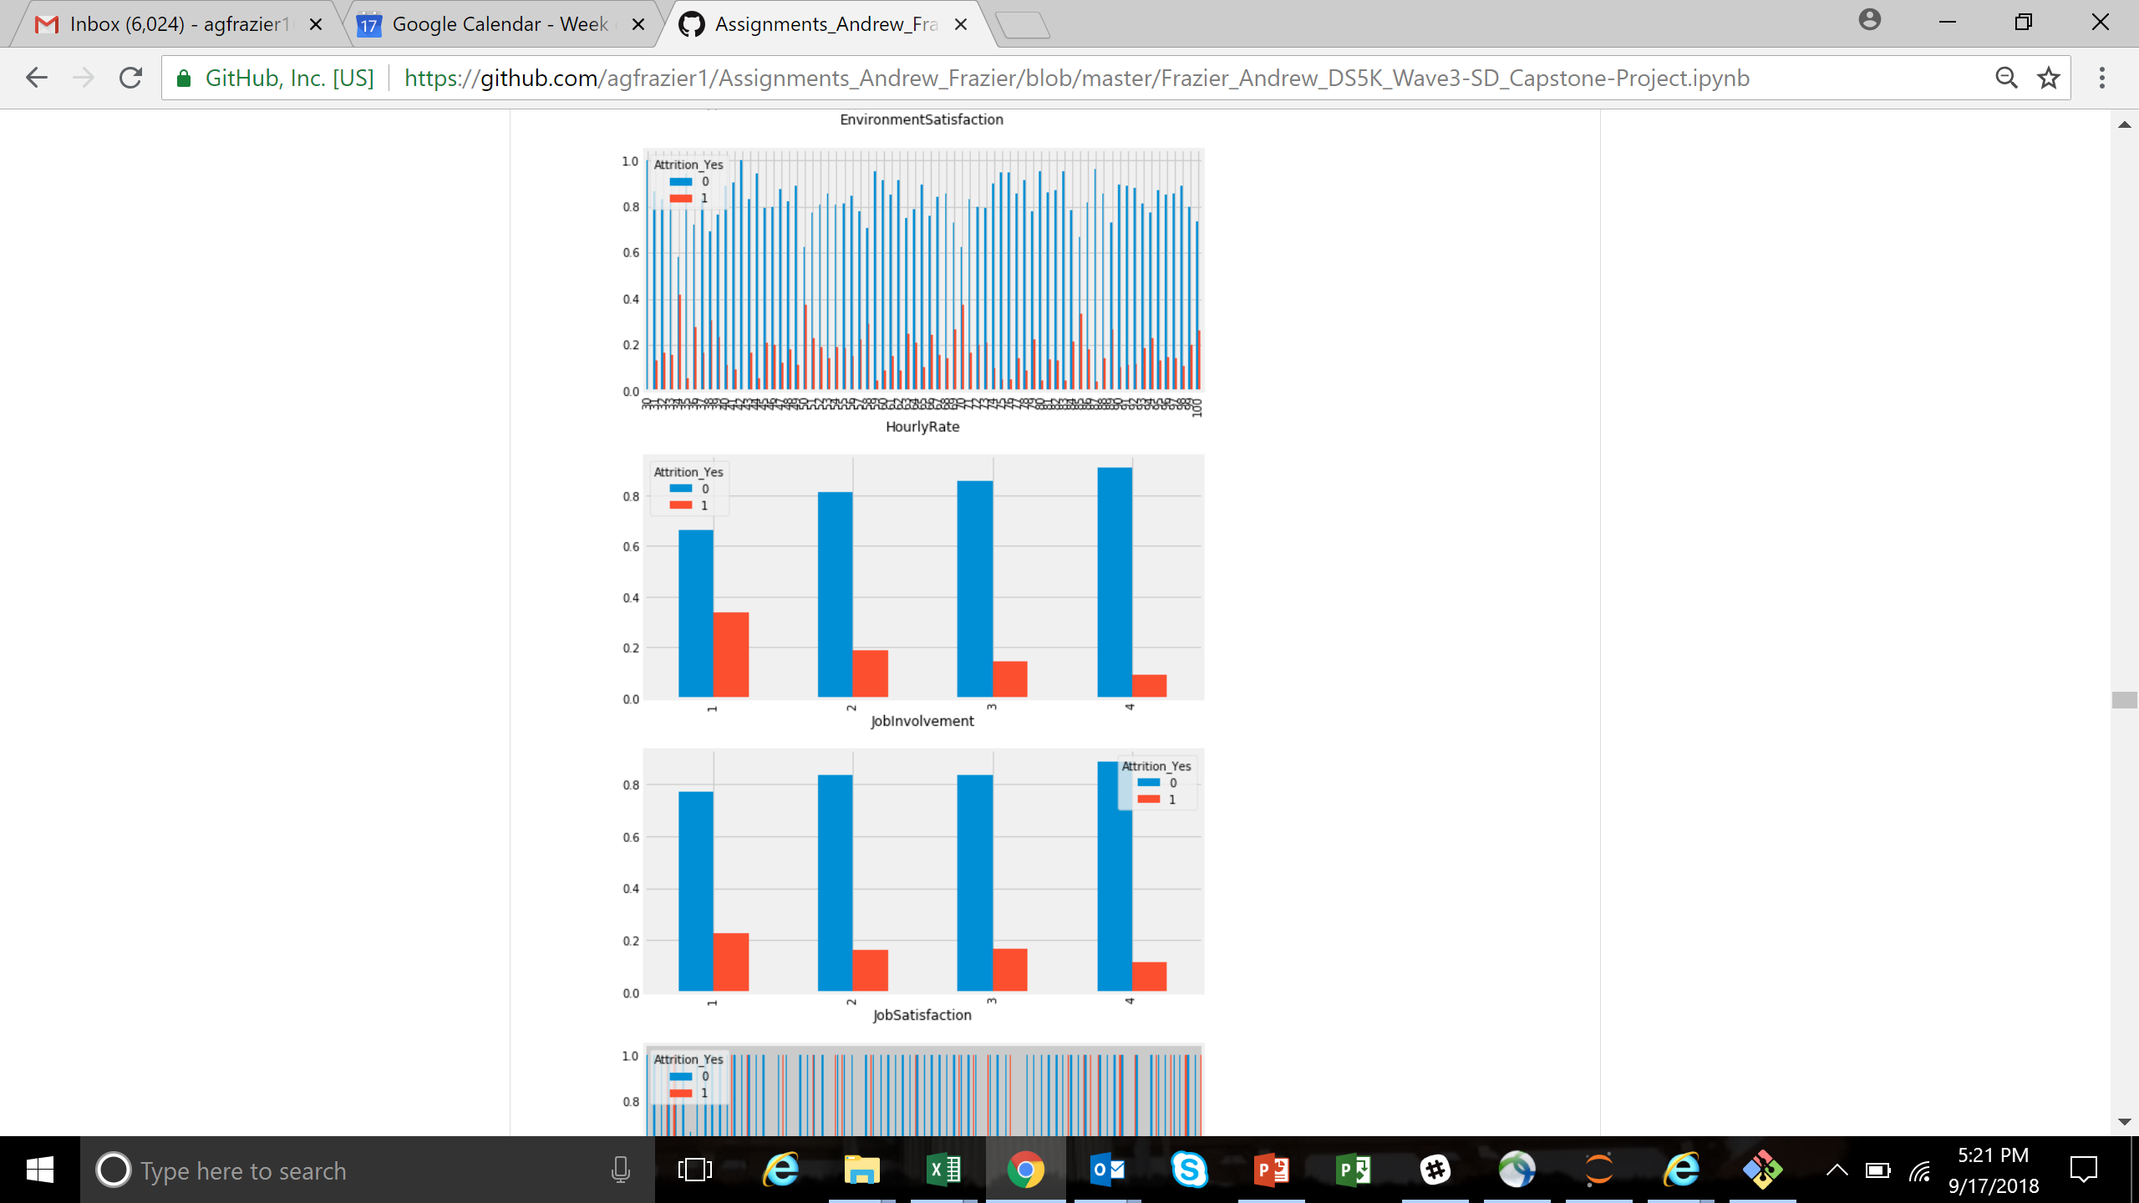
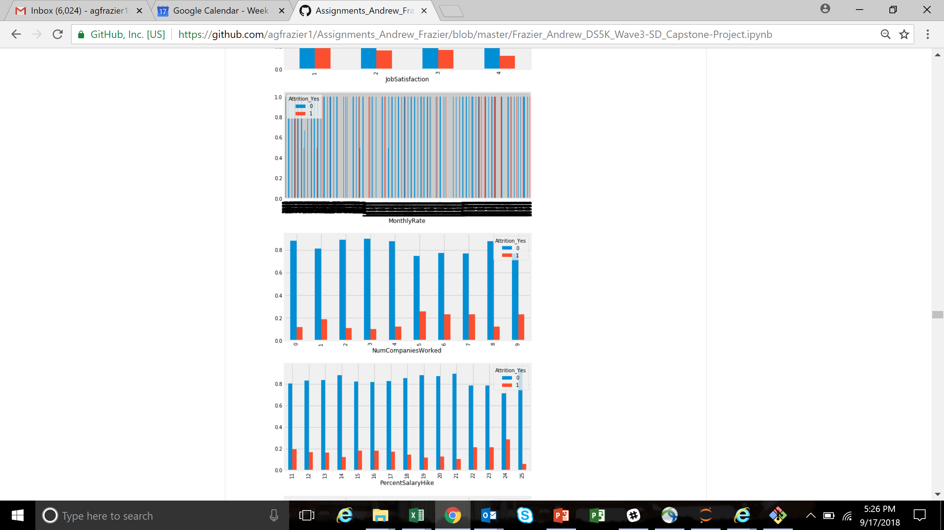
Exploring Features – Data Visualizations

Slide 10
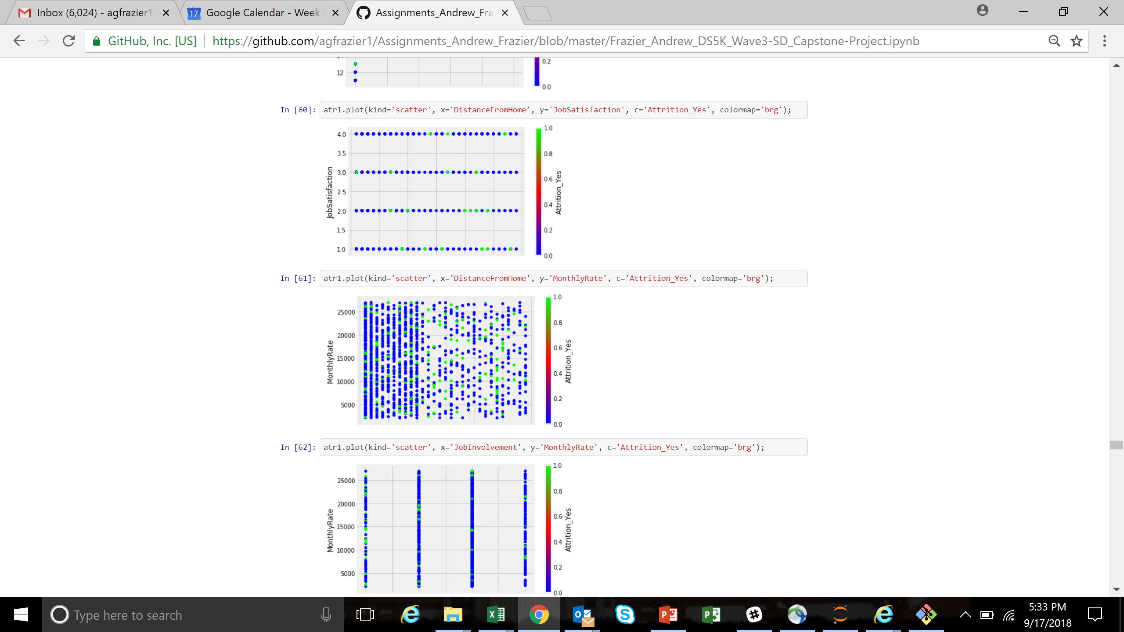
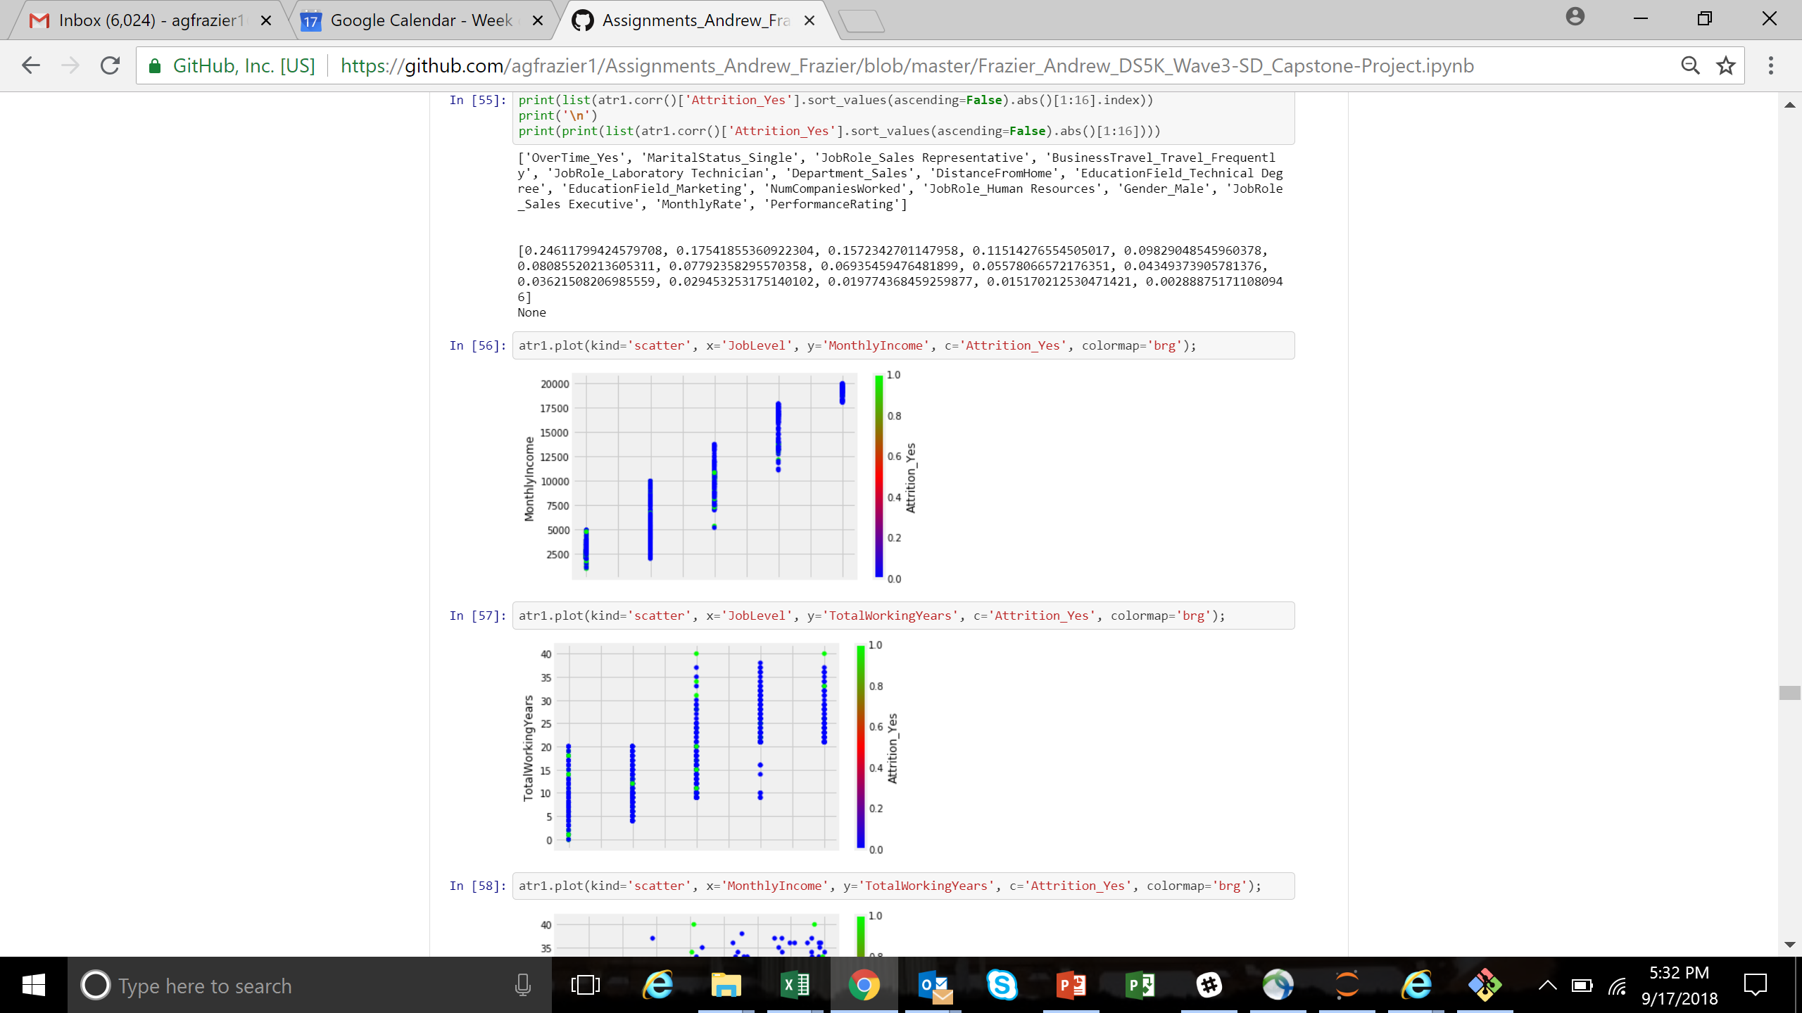
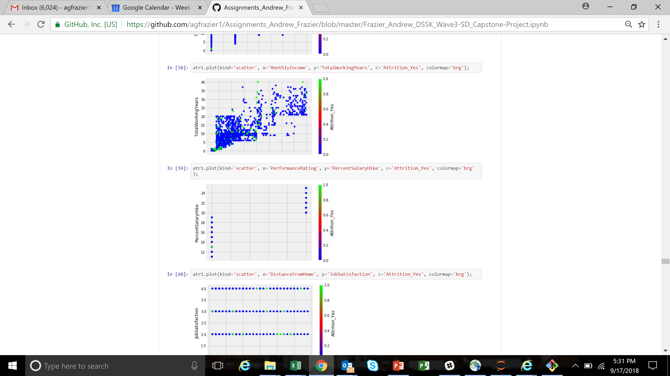
Exploring Features – Data Visualizations
Monthly Rate
Distance From Home
Job Level
Monthly Income
Job Involvement

Slide 11
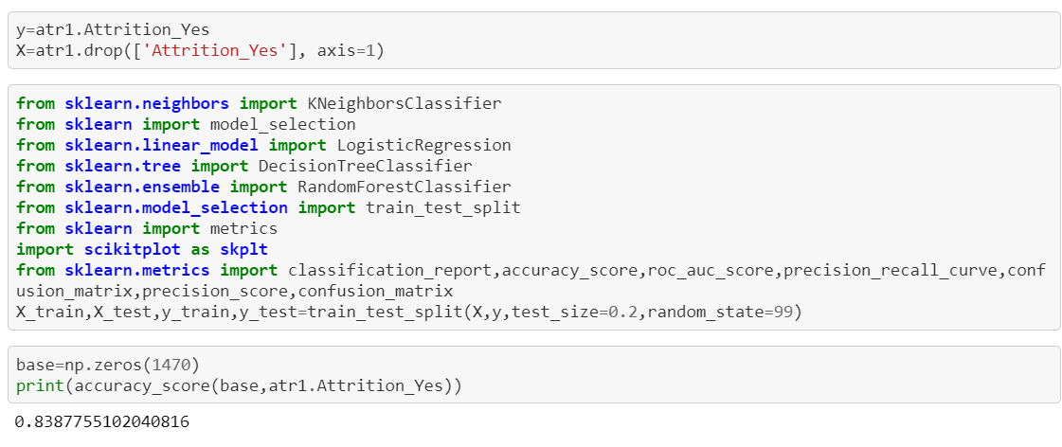
Done with the EDA Do-loop
At this point, ROI on EDA is a bit limited within time constraints (and skill set)... time to move on to a model
KNN
Logistics Regression
Decision Tree
Random Forest

Slide 12
Model Performance
At this point, ROI on EDA is a bit limited within time constraints (and skill set)... time to move on to a model
KNN (.82 Accuracy)
Logistics Regression (.85 Accuracy)
Decision Tree (.85 Accuracy)
Random Forest (.83 Accuracy)

Slide 13
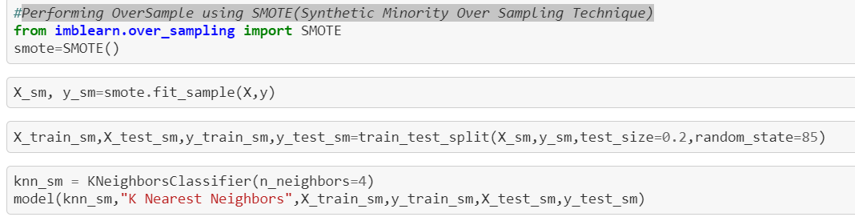
Model Performance – Weak Signal
Performing Over-sampling using SMOTE (Synthetic Minority Over Sampling Technique)
KNN ( was .82 Accuracy, now .79 Accuracy)
Logistics Regression (.85 Accuracy, now .80 Accuracy)
Decision Tree (.85 Accuracy, now .87 Accuracy)
Random Forest (.83 Accuracy, now .91 Accuracy)
While overall accuracy did not always improve in overall model, it did always improve significantly in predicting minority class – Attrition_Yes
Note – changed Random state from 99 to 85 for better Random Forest

Slide 14
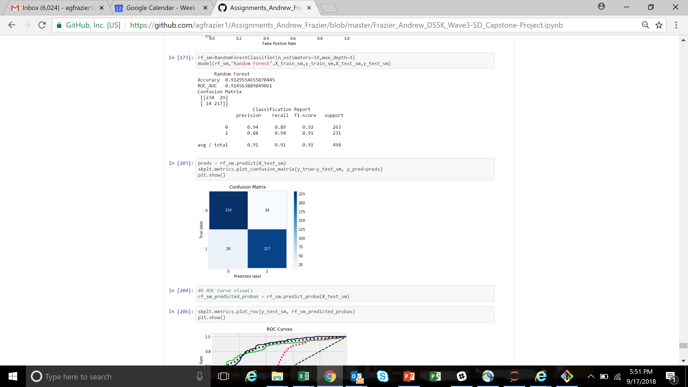
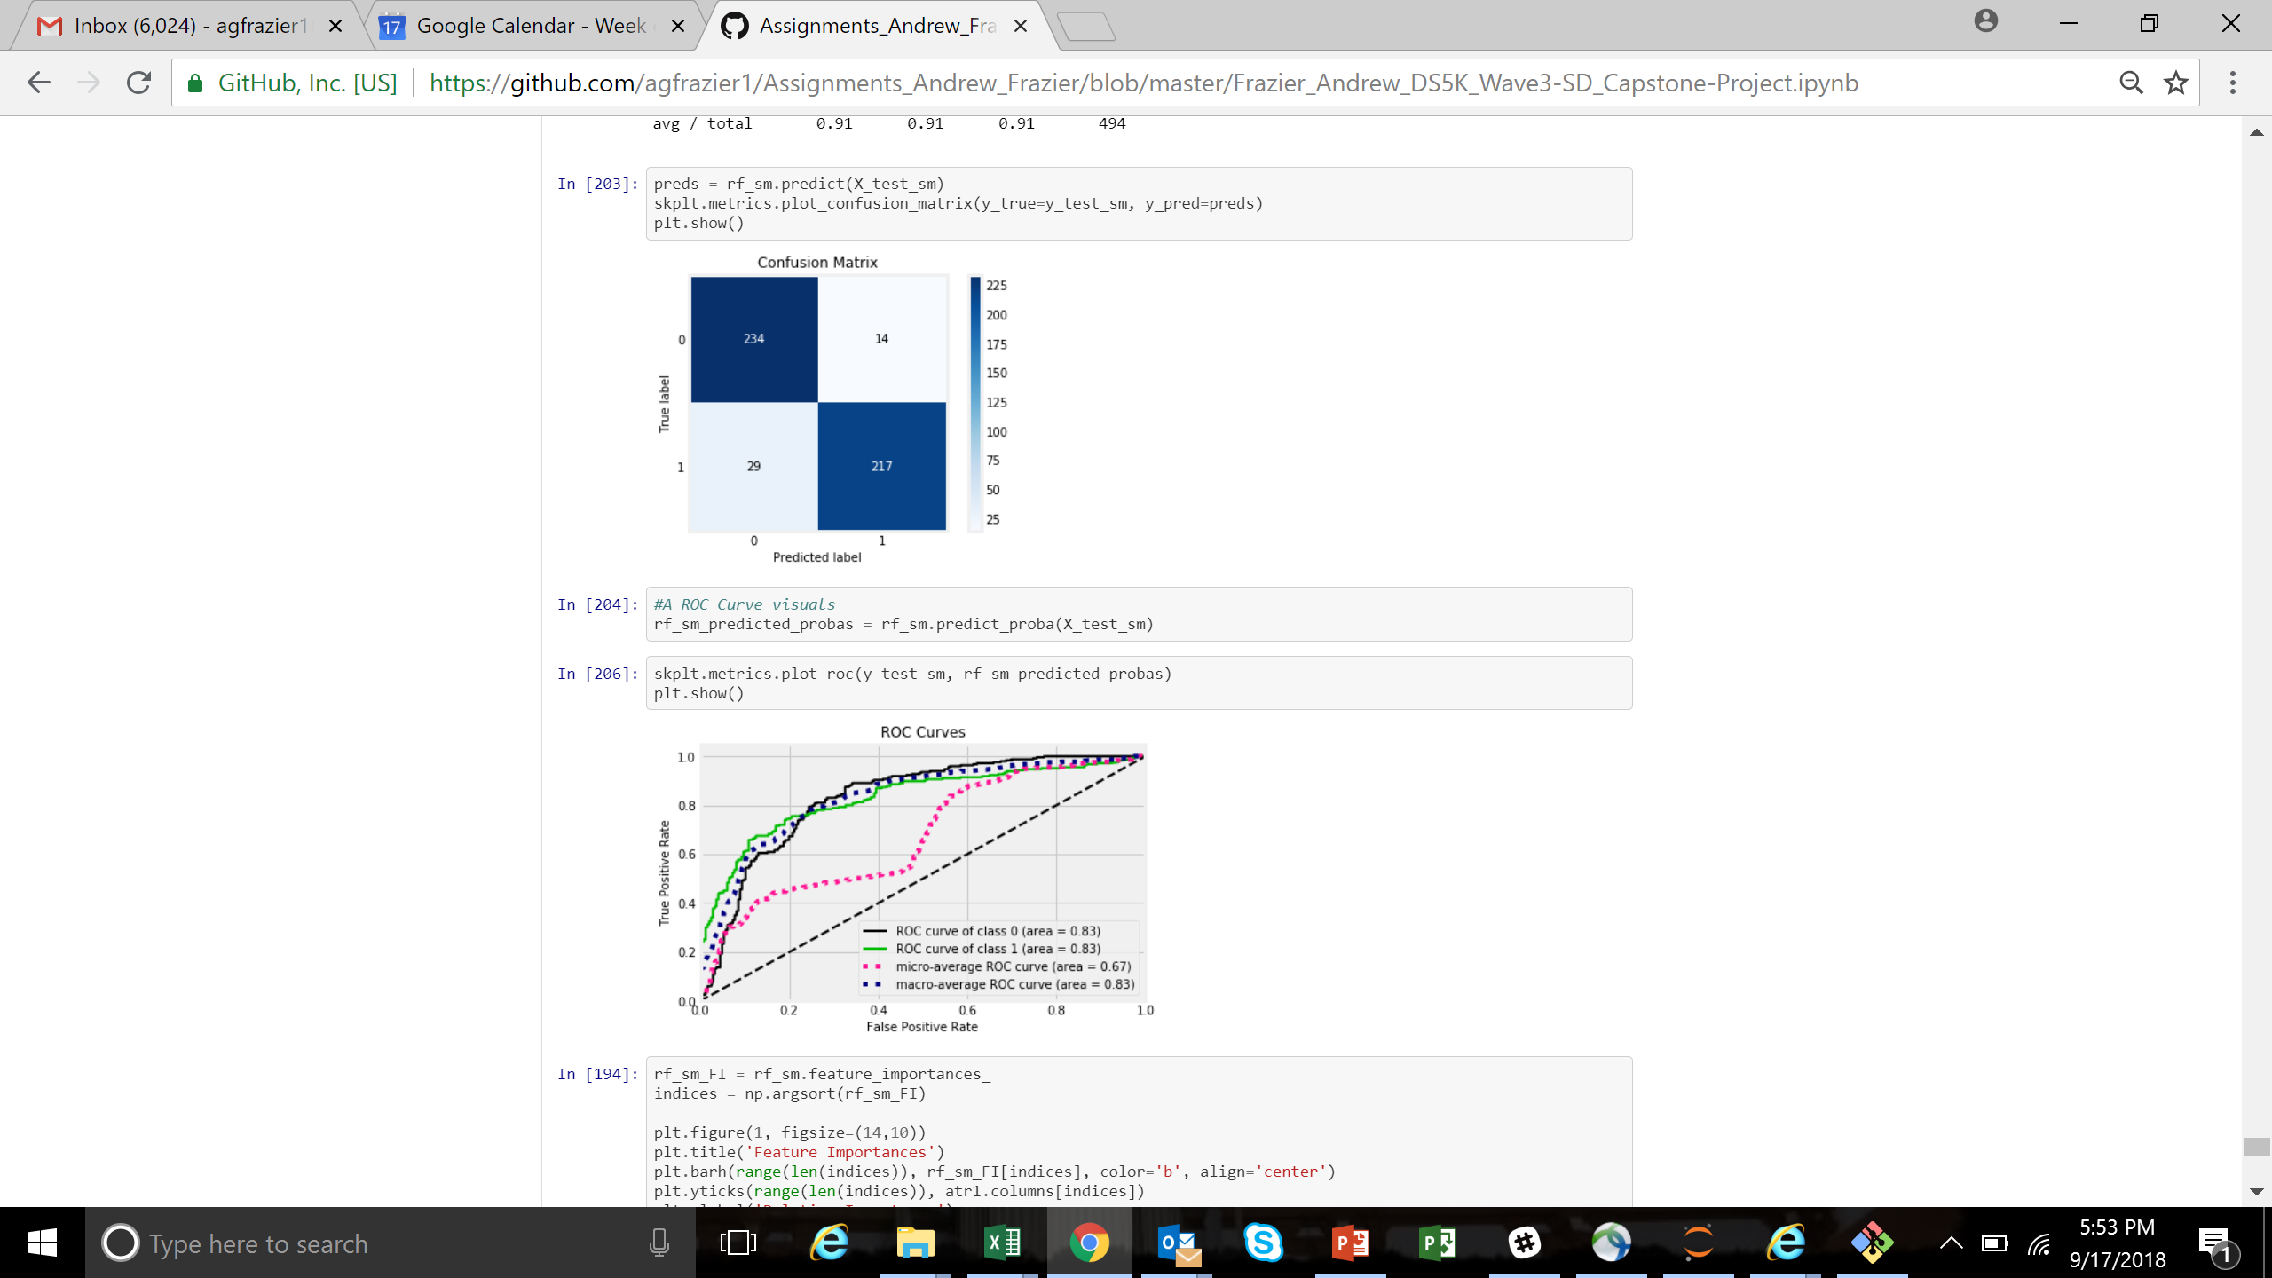
Model Performance – SMOTE RF

Slide 15
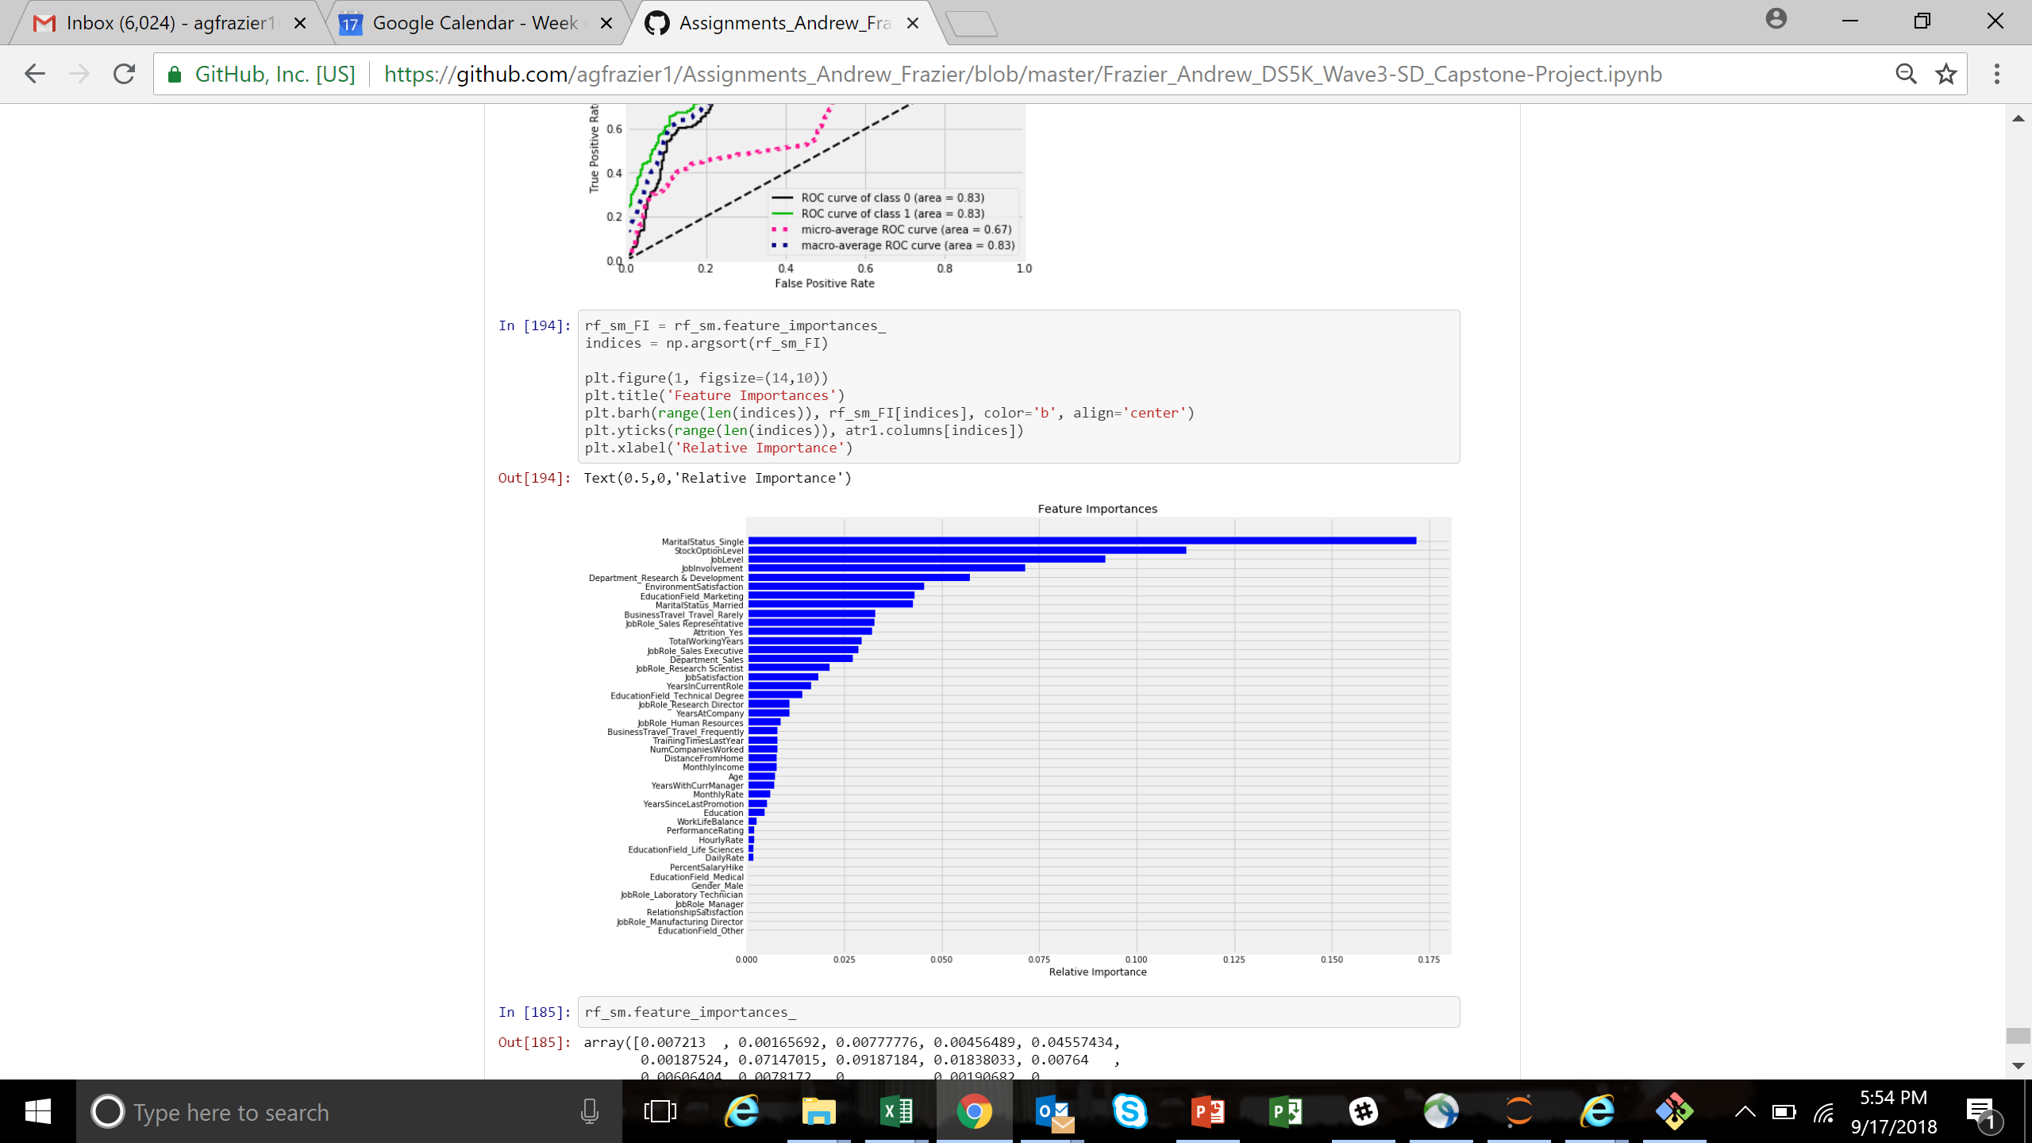
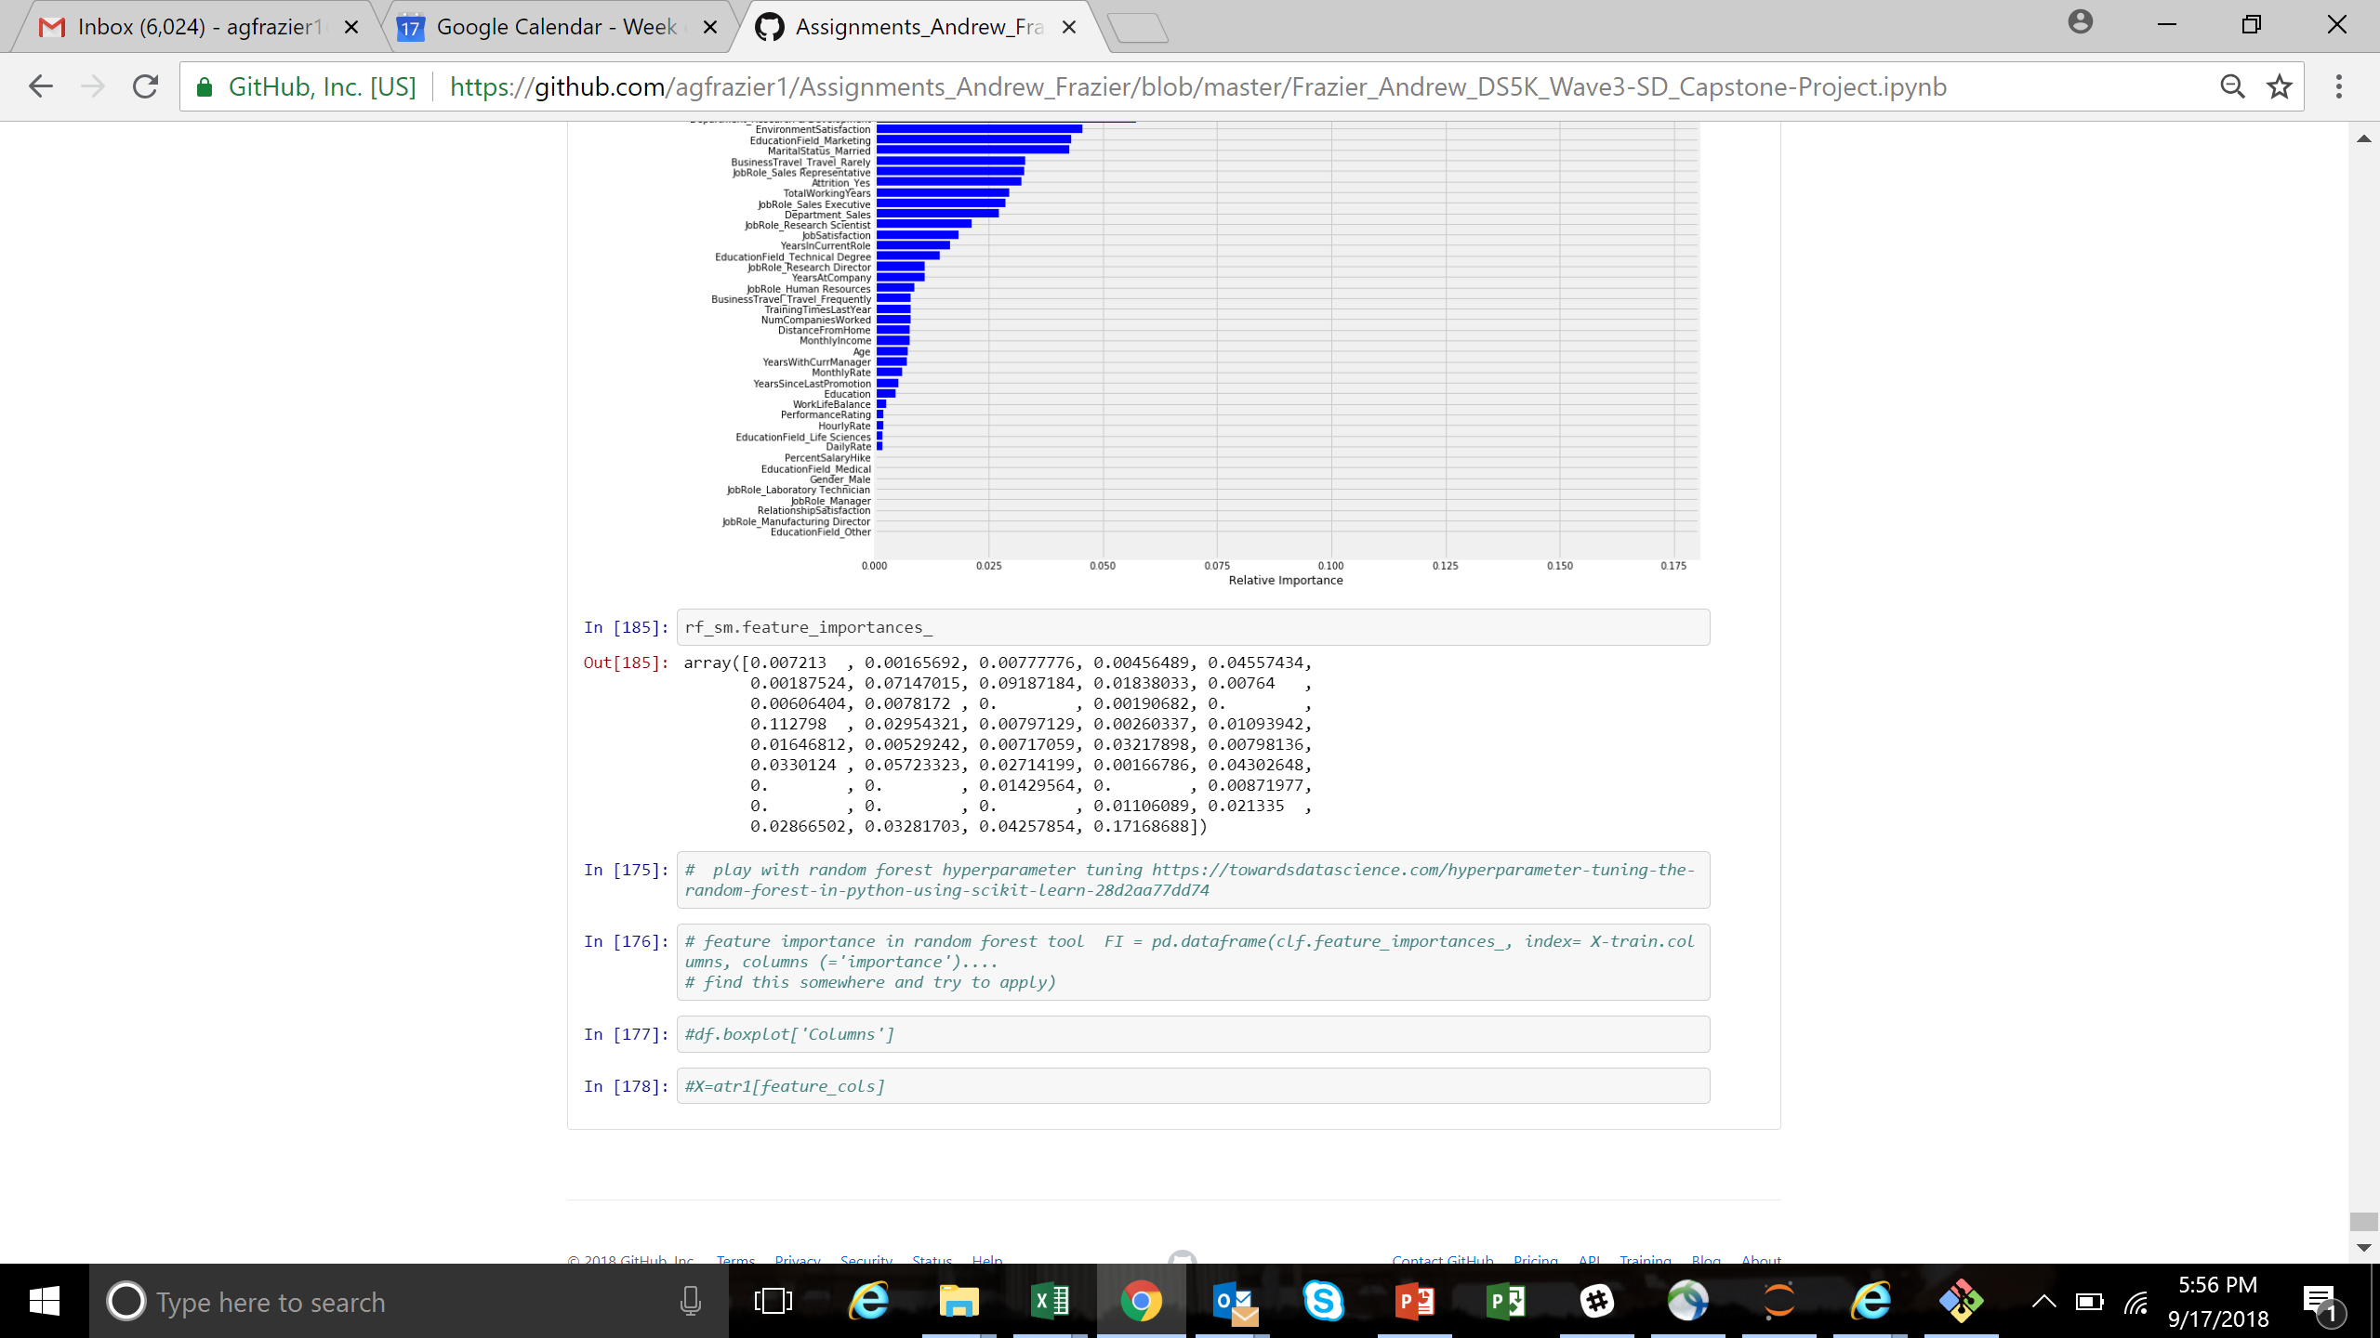
Model Performance – SMOTE RF

